Slide 1
ACLS 2015
Fine tuning of 2010

Slide 2
C P R
2015

Slide 3
Objectives
Chain of survival
CPR highlights
Arrest algorithms
Patients with a pulse
Post arrest care
Special cases – when acls fails

Slide 4
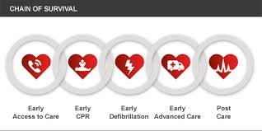
Chain of Survival

Slide 5
Early Access to Care
In any situation the quicker we react the better
Why is prehospital survival in Seattle 40%?
Smart phone prevalence recognized

Slide 6
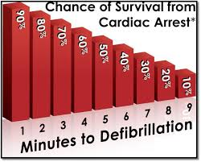
Why time matters

Slide 7
Survival Decline
Every 1 minute delay – 10% decrease in survival
Quality CPR may slow delay by 3 or 4 %
Compression only

Slide 8
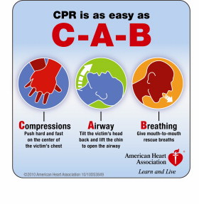
CPR

Slide 9
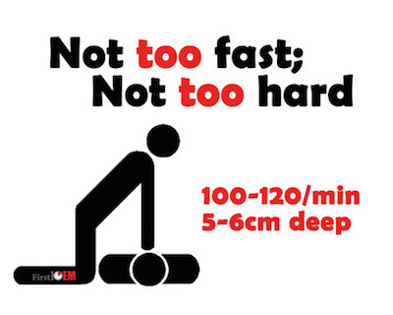
Optimal CPR

Slide 10
CPR
100 – 120 per minute
2 inch depth
Allow recoil
No pause > 10 seconds (we can do better)
10 breaths per minute –
Heart and Stroke suggests 30 : 2

Slide 11
Do we have to do 30:2 ?
ROC CCC study – continuous vs 30:2
Survival outcomes similar
Seattle follow continuous cpr protocol
Don’t over ventilate

Slide 12
Opioid Overdose
Prevalence staggering
Trained rescuer
Not breathing – has pulse
Naloxone
Some high risk groups now carry
Drugs cut with Fentanyl

Slide 13
Defibrillation
ASAP
AED
Standard Device
No device or energy felt to be superior

Slide 14
Hot Issues
Dual shocks / simultaneous
No pause shocks
Neither ready for prime time

Slide 15
Advanced Care
There has never been an antiarrhythmic medication that has shown any long term survival benefit in cardiac arrest
2016 will have results of ALP trial – Amio, Lidocaine and placebo
Current suggestions guideline

Slide 16
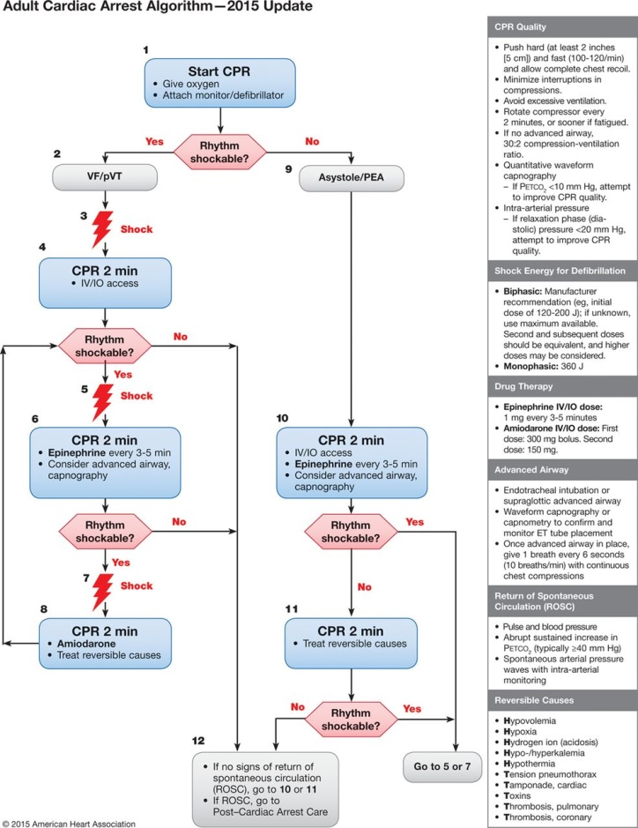
Arrest Algorithm

Slide 17
Arrest drugs
Epi
Amiodarone
Vasopressin removed

Slide 18
Epinephrine
Remains controversial
VF/VT not given in first round
PEA given at outset
Myocardial irritation/ coronary spasm
Dosing 10 cc of 1/10,000 (1 mg)

Slide 19
Amiodarone
ALP trial will likely decide fate
Arrest and Alive trials best to date
300 mg push bolus / 150 mg push bolus

Slide 20
Optimize CPR
Minimal delays
Change roles
Quick shocks
Maintain rate/quality

Slide 21
ET CO2
Confirms tube placement
< 10 – bad prognosis
CPR marker – 12 – 15
ROSC – sudden rise

Slide 22
Other Options …
Alternate CPR devices
Impedance threshold device
Active compression/ decompression
ECMO – reversible situations

Slide 23
What about Mentzelopoulos?
Vasopressin, epinephrine and steroids
Single centre
Improved in patient arrest survival
Very low base survival rates (5%)
IIb – not ready for mainstream

Slide 24
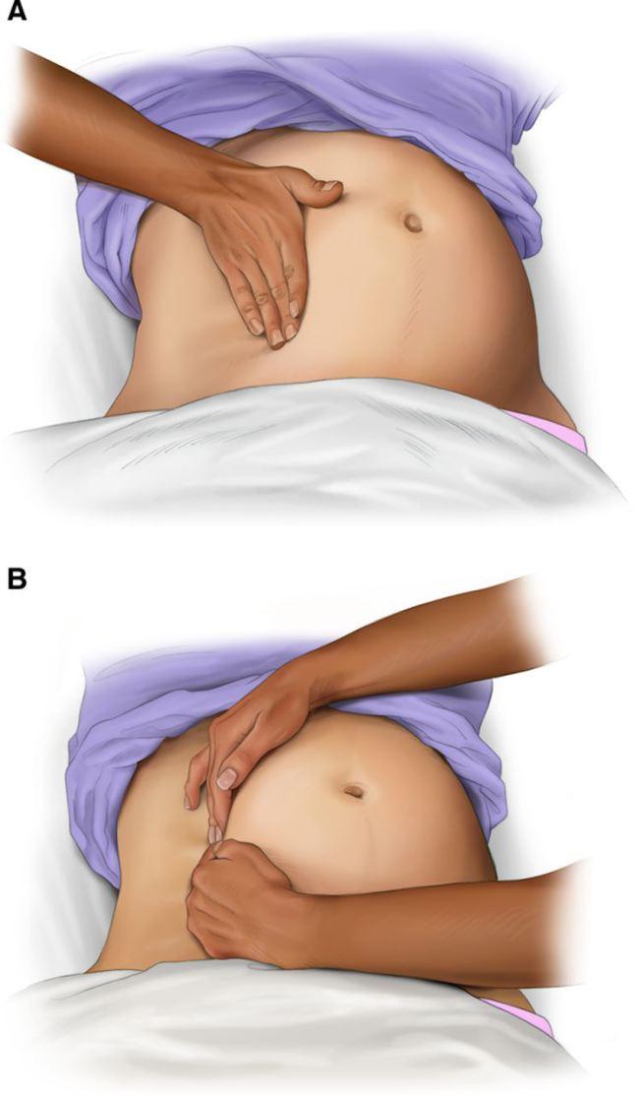
Pregnancy CPR

Slide 25
Pulseless Electrical Activity
Give epi first round
Think differentials
US may help

Slide 26
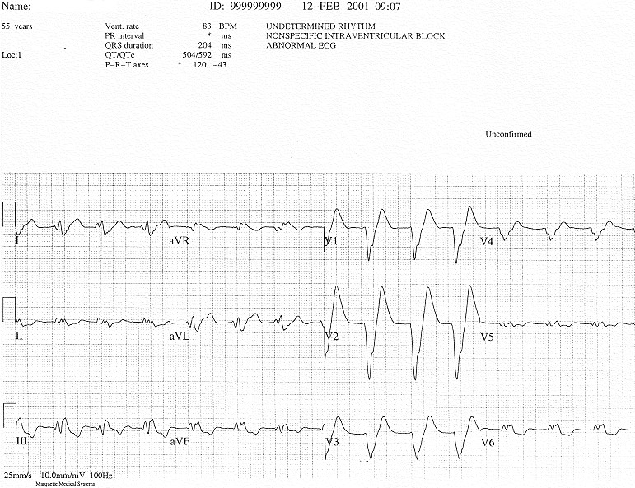
PEA

Slide 27
PEA
Hypoxia
Hydrogen
Hypovolemia
Hyper K/Hypo K
Hypothermia
Hypoglycemia
Tablets
Tension
Tamponade
Thrombus MI/PE

Slide 28
Algorithm
Use it to get started CPR / Epi
Think – use chart
US helpful
Overdose antidotes
PE issue

Slide 29
Pulmonary Embolism
High suspicion
Lyse early
No benefit in AMI

Slide 30
ROSC
Move
Inc ET C02
Inc wave on art line
Pulse at pulse check

Slide 31
Prognosis
History
During arrest
Age > 75
Unwitnessed
No bystander cpr
No early defib
Initial rhythm not VF/VT
Low ET C02
No act on US
PEA
Coming cerebral pulse ox

Slide 32
Post arrest – we got him back!
TTM
Cath Lab
Hemodynamics
Oxygen

Slide 33
Targeted Temp Management
Moving target !
Was 32 degrees
Then 36 degrees
No fever
Proponents of 32/33 and 36
All agree no fever

Slide 34
Cath Lab
Done emergently if …
Clear injury pattern
Hemodynamic instability

Slide 35
Oxygen
New frontier
Sats > 94 %
Consider downsides – coronary vasoconstriction

Slide 36
Hemodynamics
Beware SBP< 90 or MAP < 65
CO = SV x HR
SV – preload , contractility and afterload

Slide 37
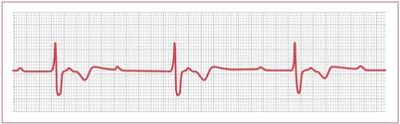
BP 80/60

Slide 38
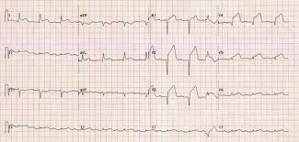
BP 80/60

Slide 39
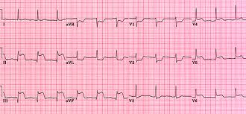
BP 80/60

Slide 40
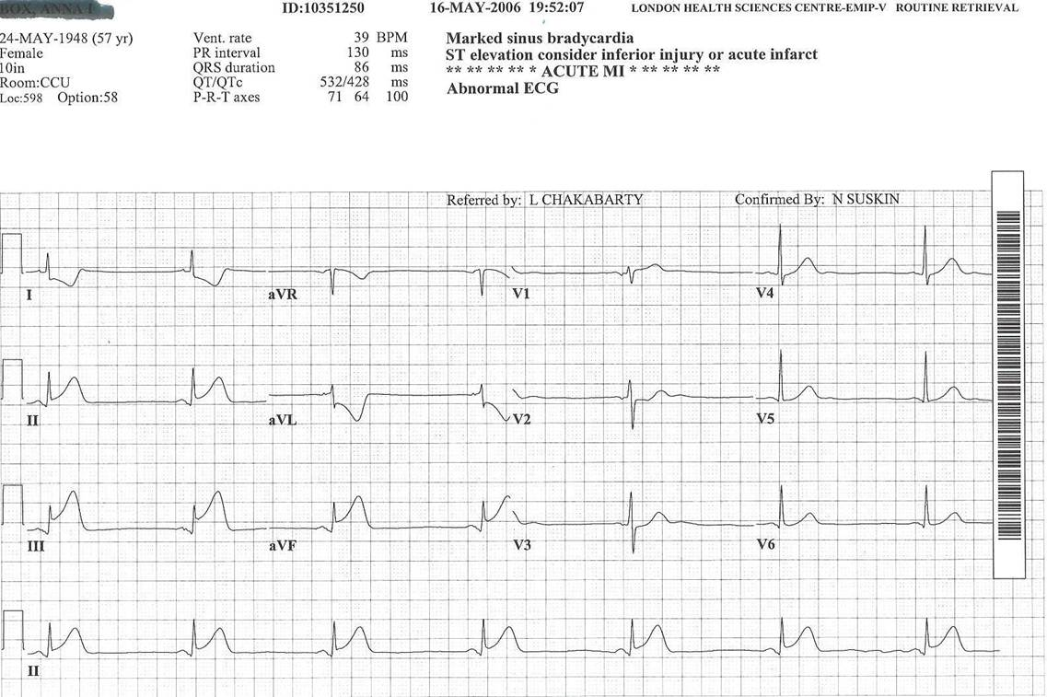
BP 80/60

Slide 41
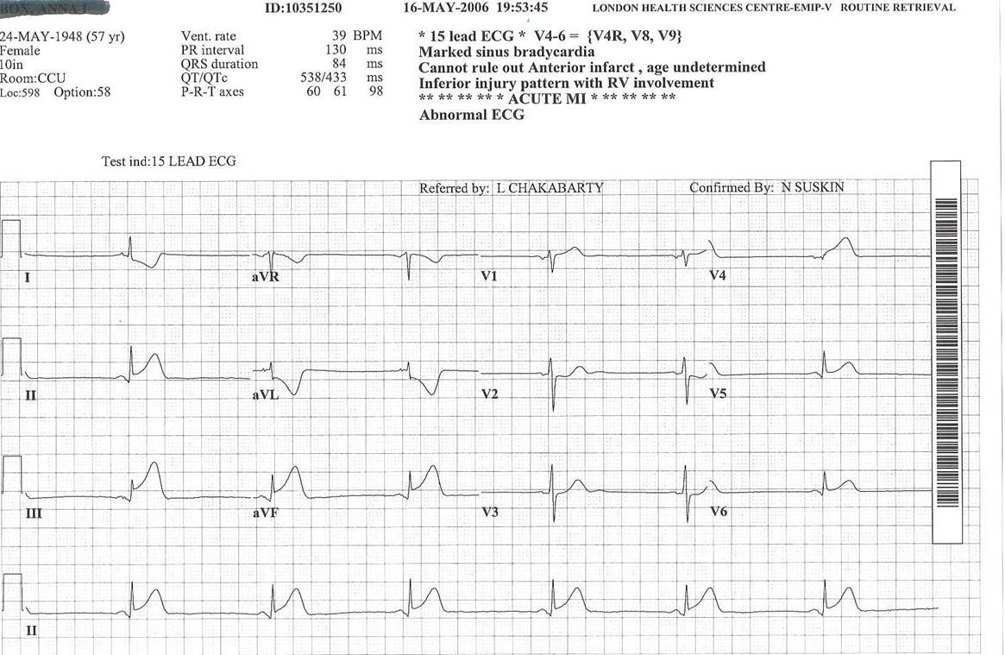
BP 80/60

Slide 42
Post Arrest
Anterior – think pump – inotropes
Inferior - think fluid - preload
Slow - speed it up

Slide 43
ACS issues
Prehospital EKG
ADP inhibition prehospital
Heparin pre hospital
Lytics vs PCI – timing < 2 hrs vs > 2 hrs
Prehospital lytics
Have a protocol

Slide 44
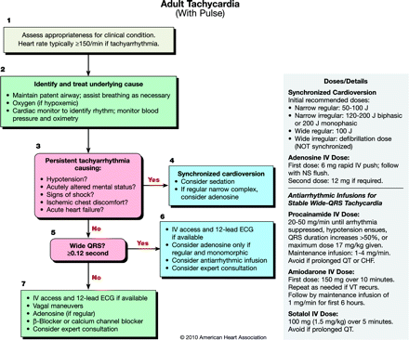
Tachycardia

Slide 45
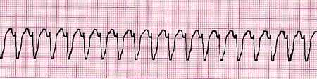
Fast HR + pulse

Slide 46
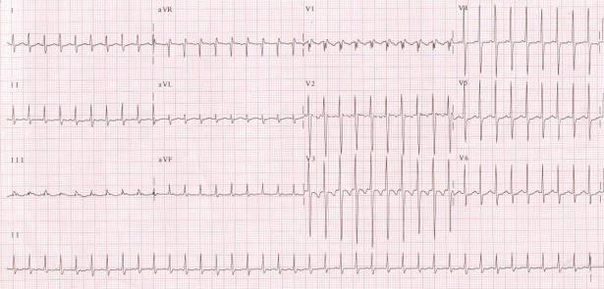
High HR +ve pulse

Slide 47
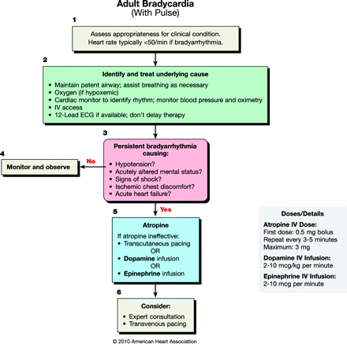
Bradycardia

Slide 48
Bradycardia
Differential important
Only treat symptomatic patients
Chest pain/SOB/hypotension

Slide 49
Special Arrests
Require additions / deviation from ACLS
Need to happen quickly

Slide 50
Asthma
Tension pneumo
Auto peep
Mucous plug
Airway obstruction
Permissive hypercapnia
Ketamine

Slide 51
Anaphylaxis
Tube early
Volume
IM epi if line delayed
vasopressors

Slide 52
Question ?

Slide 53

Hyperkalemia

Slide 54
Hyperkalemia
Slow wide complex
Calcium
Bicarb
Insulin / glucose
Ventolin
Kayexalate

Slide 55
Toxins
Beta blockers
Calcium channel blockers
Digoxin
TCA’s

Slide 56
Pregnancy
IVC compression
Magnesium sulfate toxicity
PE
Abruption
Deliver within 5 minute of arrest
Protocol suggested

Slide 57
Conclusion
2015 confirms 2010 changes
CPR and defibrillation good
Pauses bad!
Post arrest care critical
ACLS doesn’t work for everything – know the holes

